Slide 1
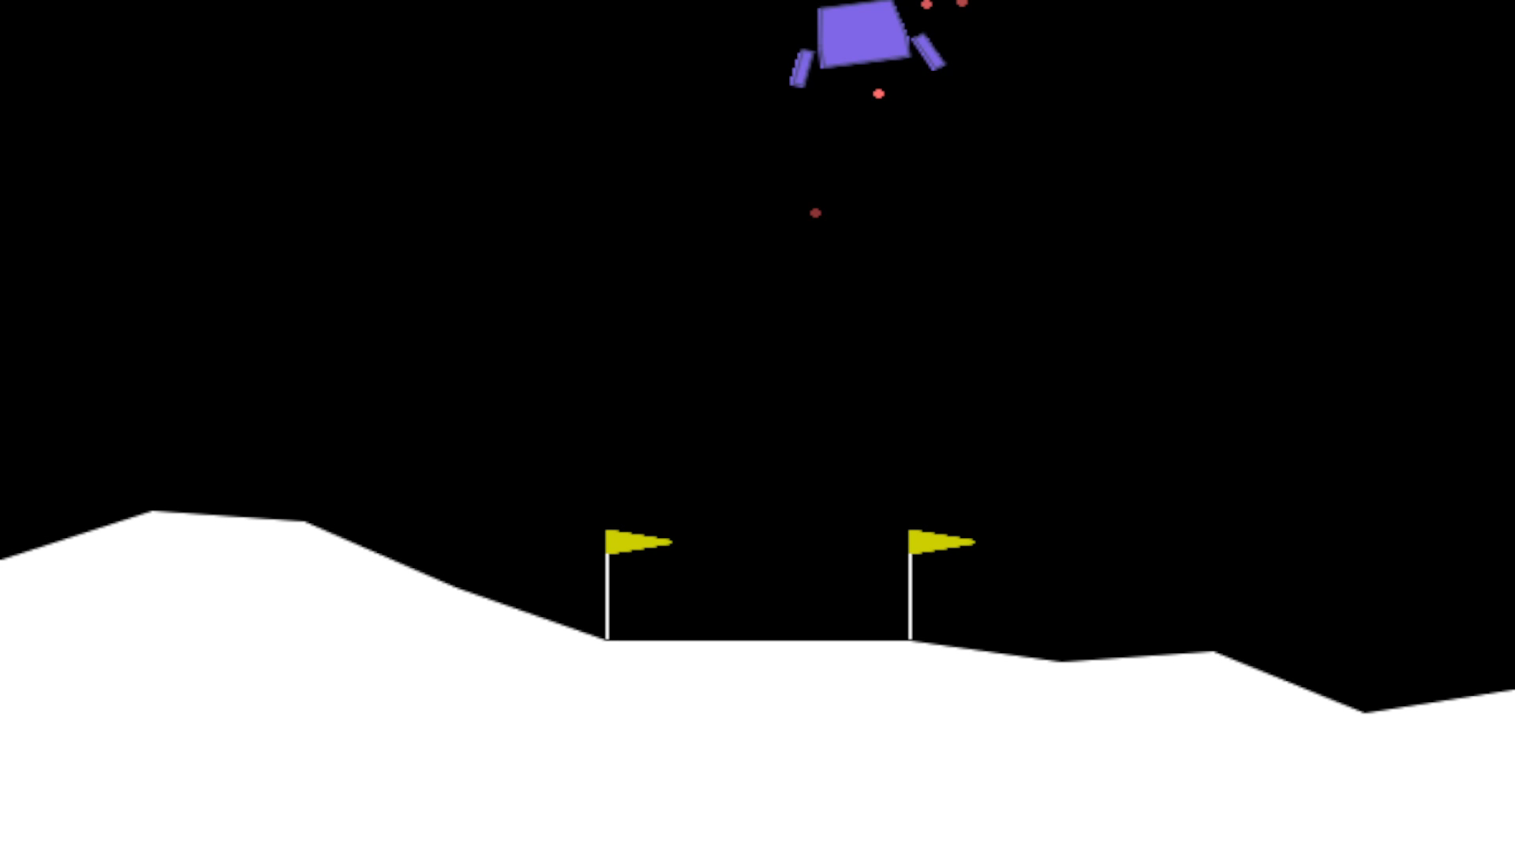
Untrained Agent
Notes:
As you can see, our untrained agent performs incredibly poorly as no learning has taken place. It achieves an
average reward of -600 over 100 simulated episodes.
After 150 episodes of training, the agent has begun to learn to contol itself, although fairly slowly. This yields an
average reward of 0 over 100 simulated episodes, demonstrating that some learning has taken place
And finally we see the fully trained DQN agent. We consider our agent fully trained when it achieves an average reward of 200
over the last 100 episodes of training. This occurs at around 320 episodes on average, with an average reward of 240 over
100 simulated episodes
And as you can see by the graphed agent simulations, it is clear to see that learning has taken place.

Slide 2
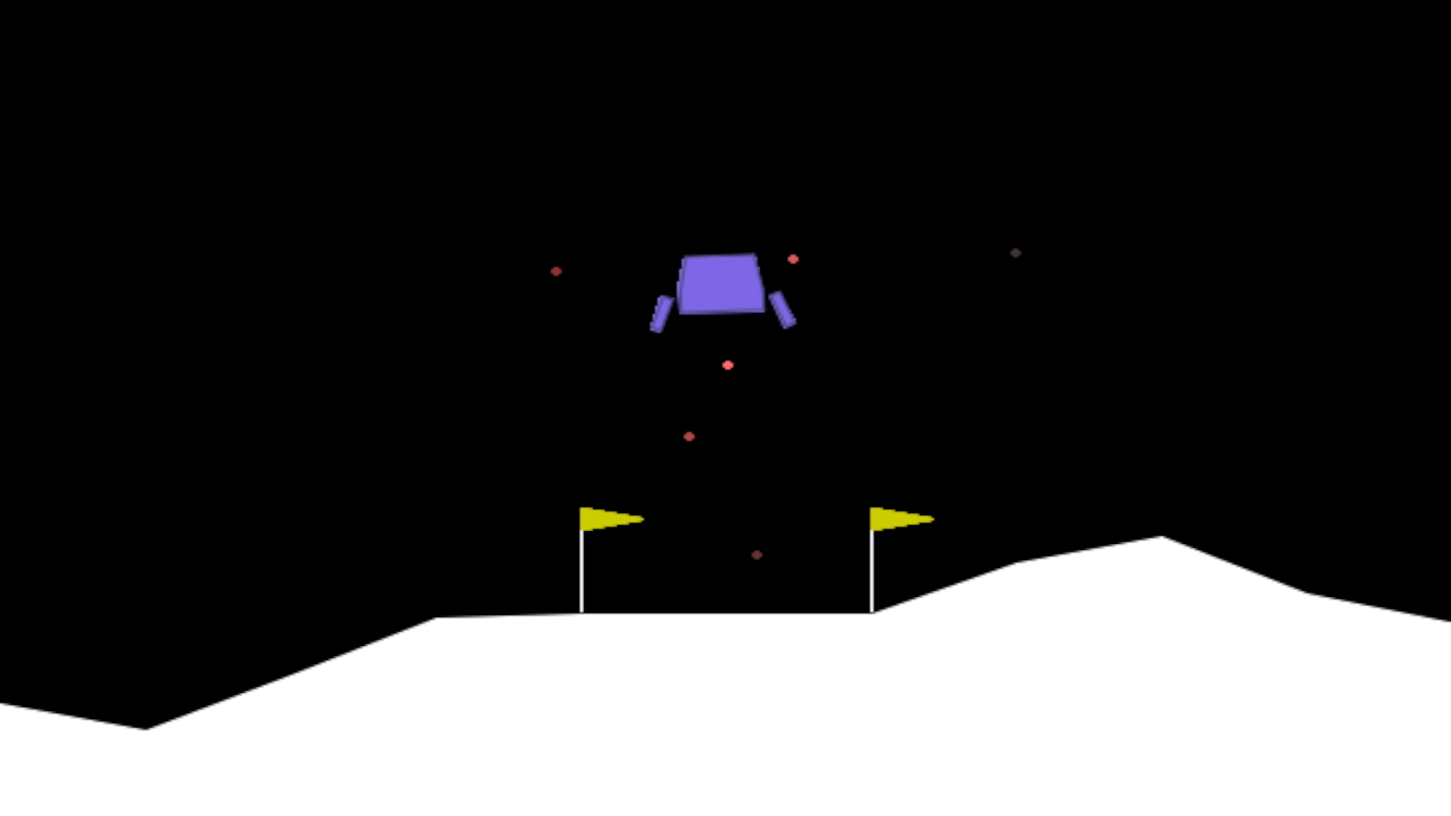
Agent after 150 episodes of training

Slide 3
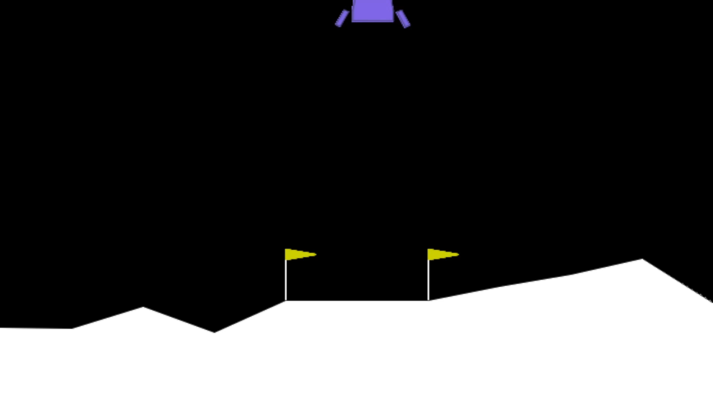
Fully trained DQN agent

Slide 4
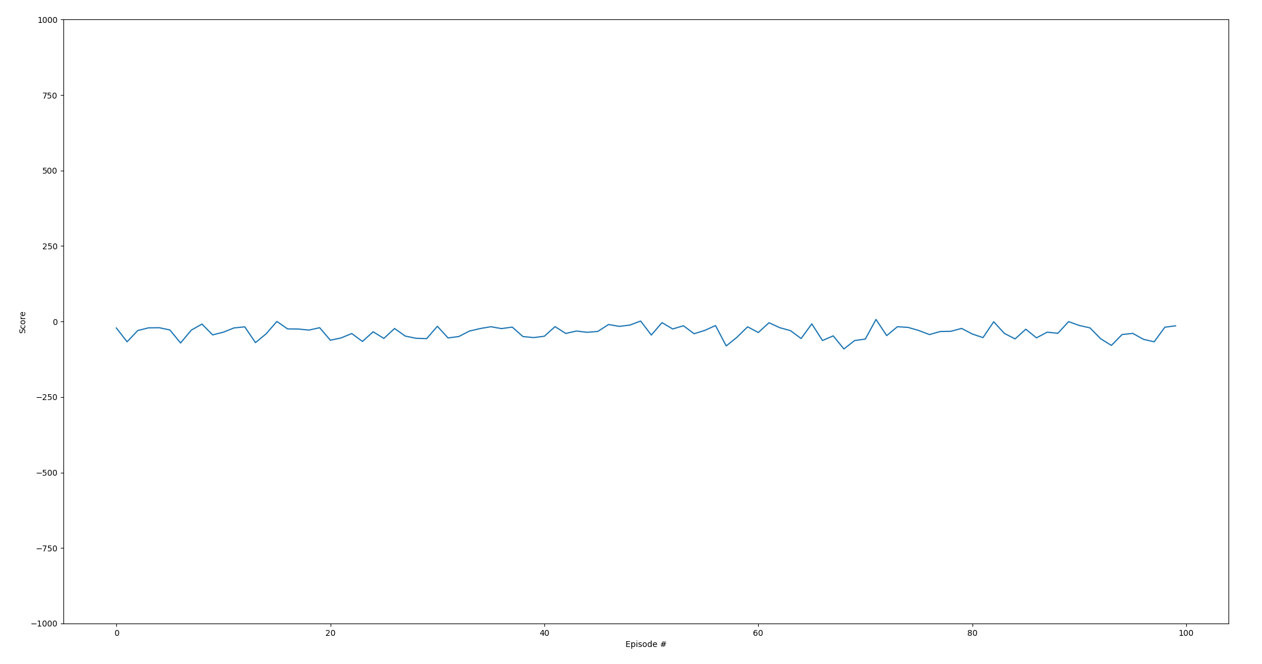
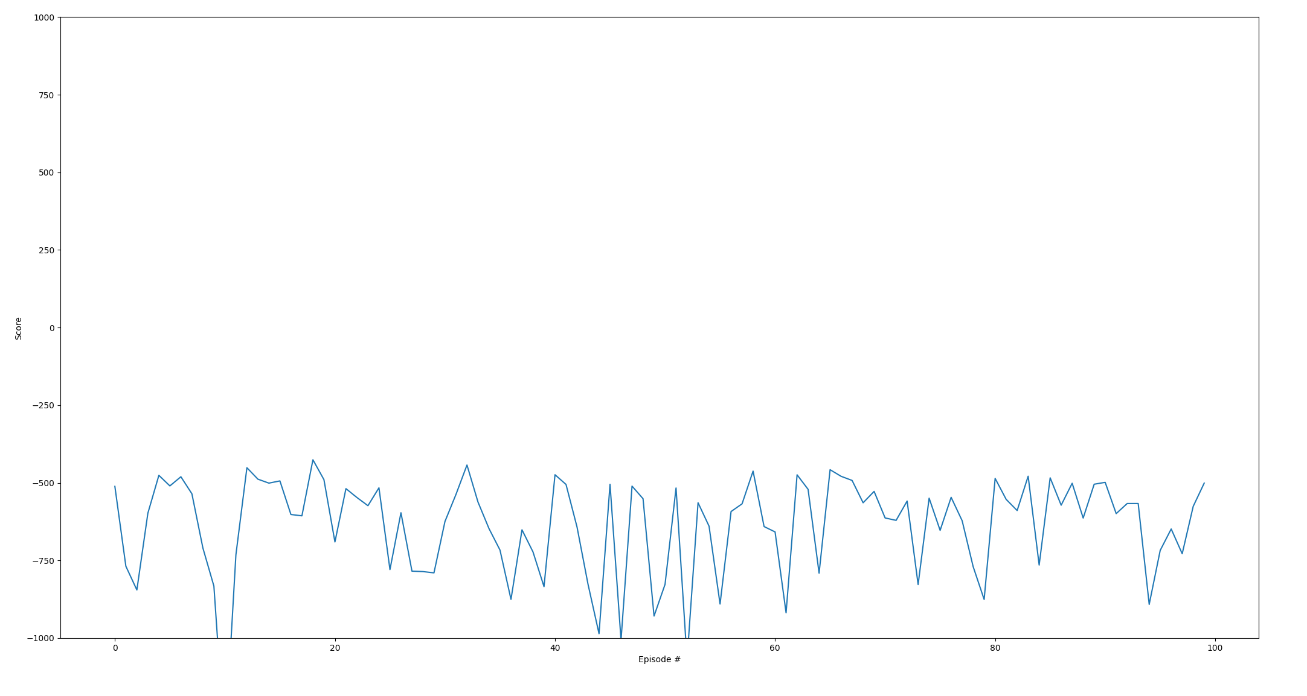
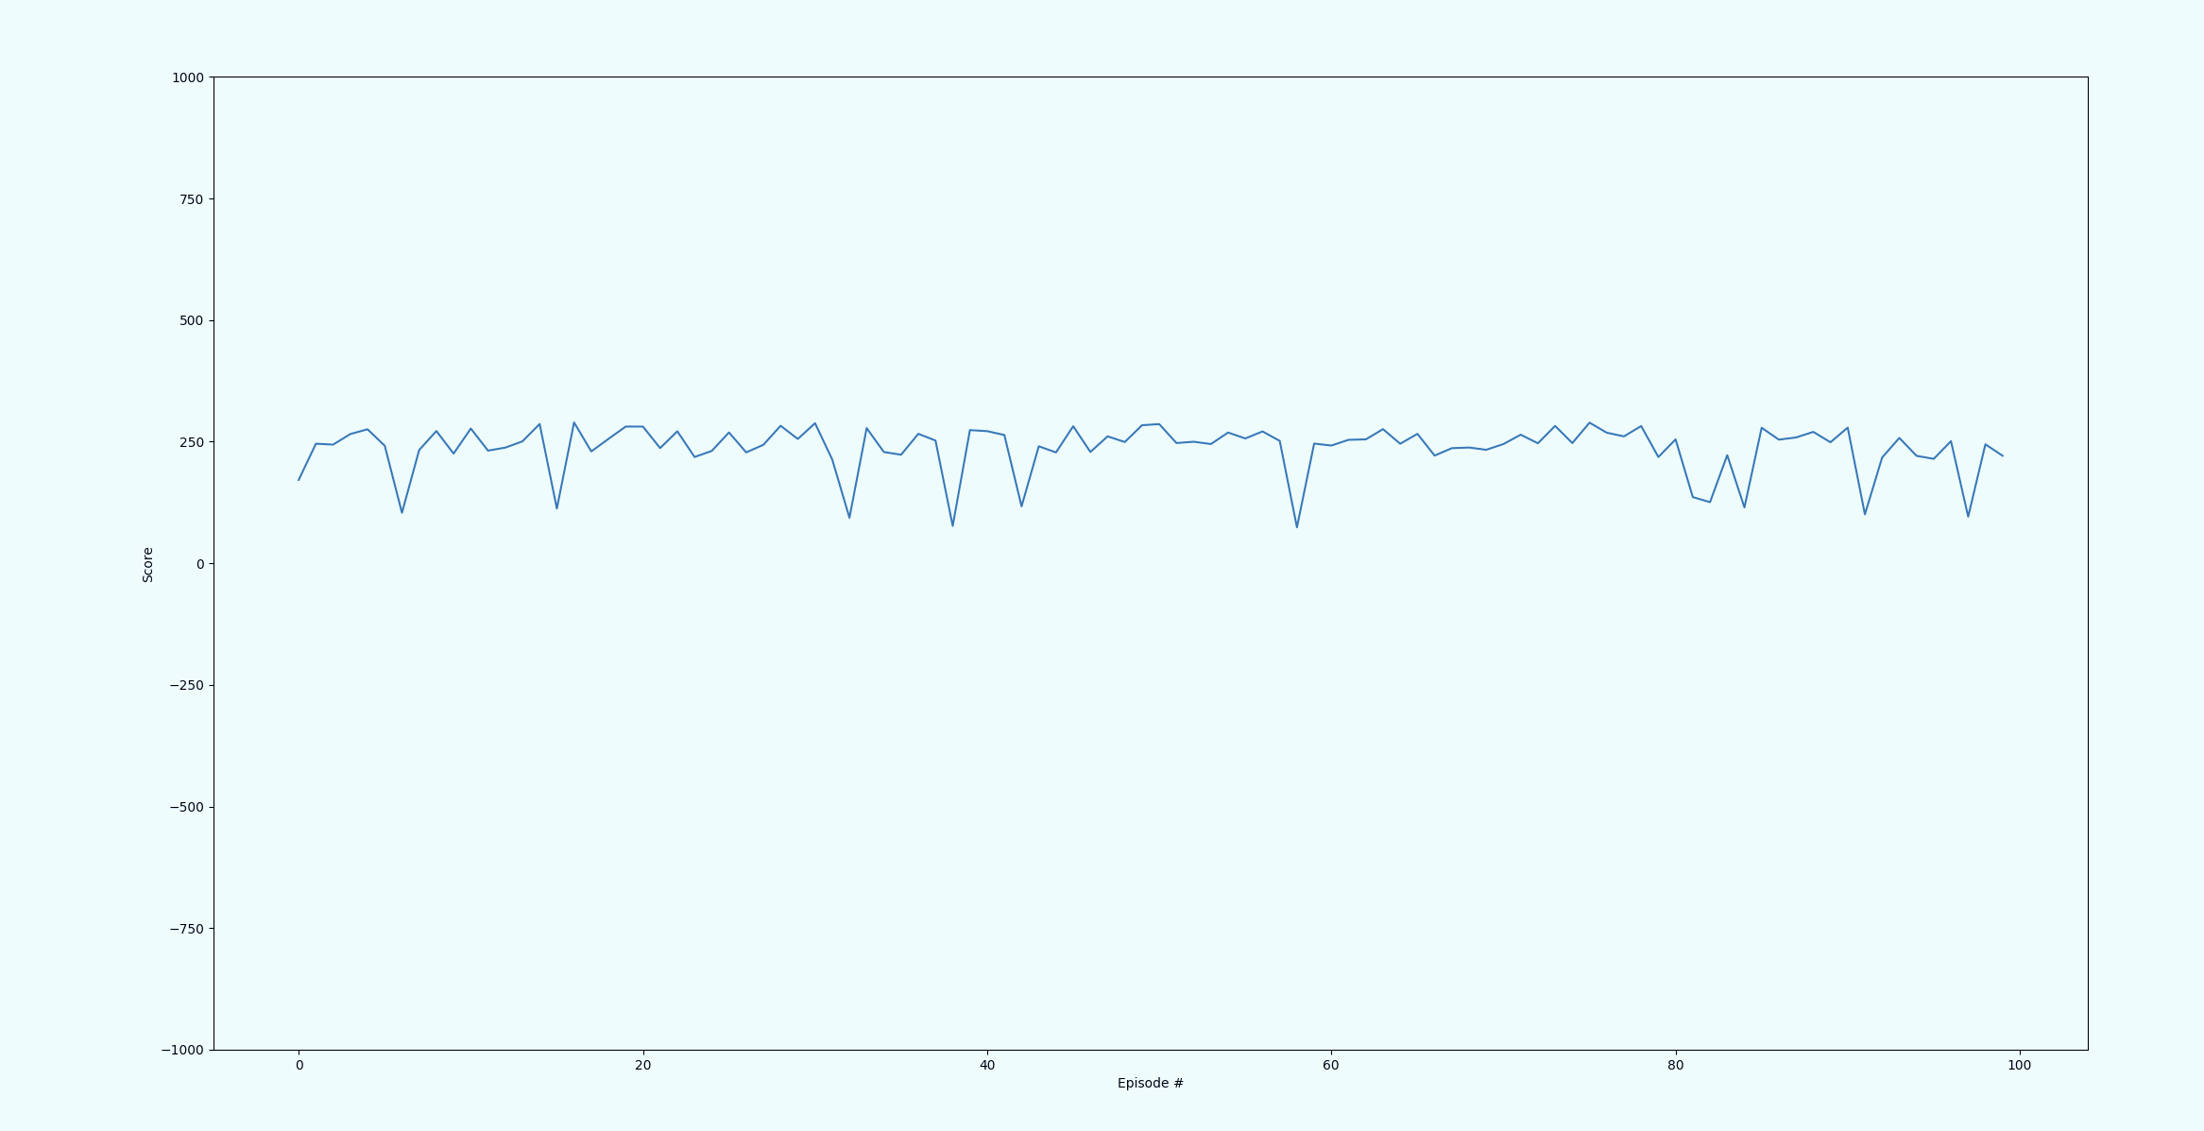
All 3 Agents simulated over 100 episodes

